Slide 1
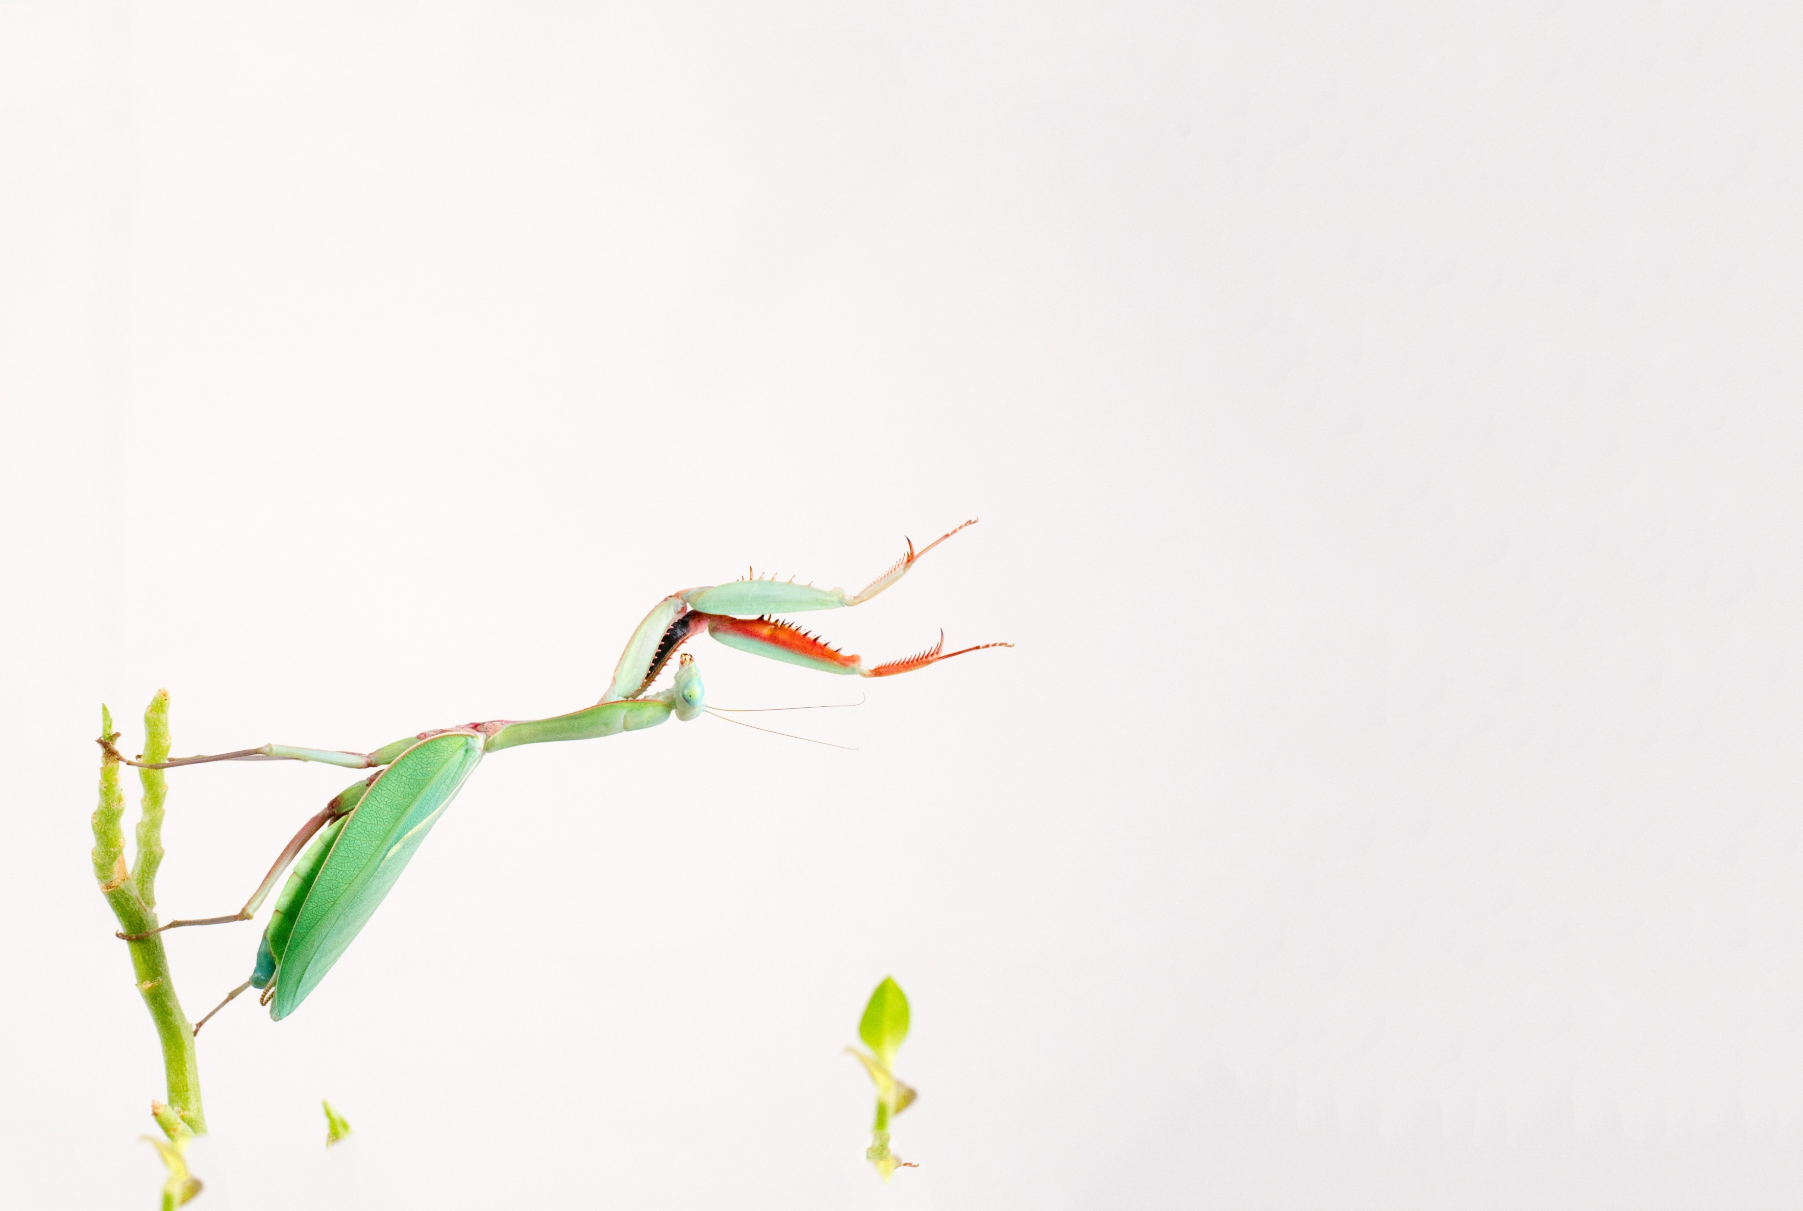
MantisAI Automating pivot point detection in insect movements Linus Prinz, Fabian Bäumler and Alicem Susam
16.01.2025 - Machine Learning with TensorFlow
Notes:
Title Slide: Project name, names of the project team, date, and any other relevant information.

Slide 2
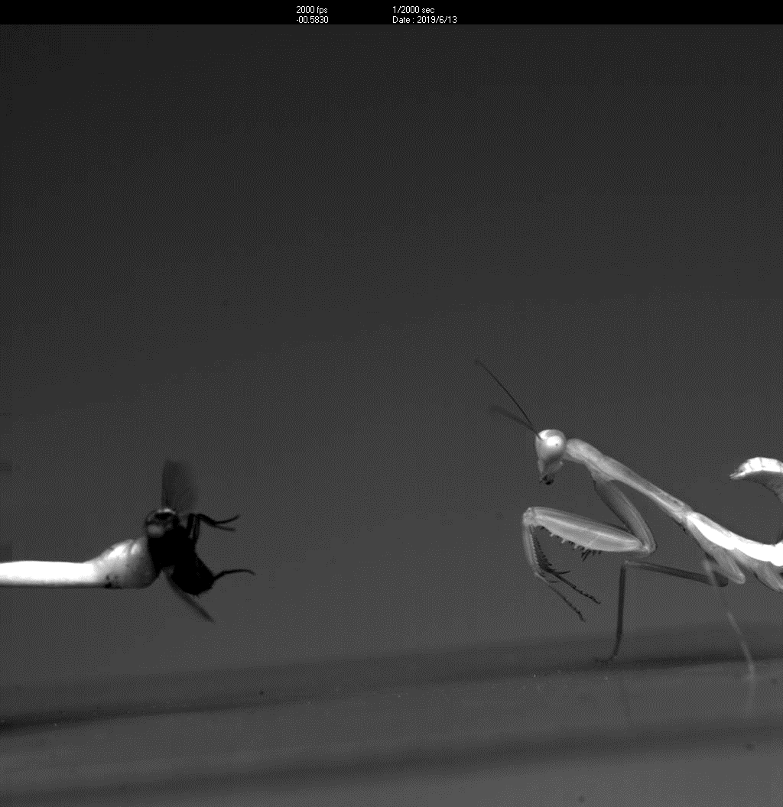
Striking for prey
Adult Mantis religiosa in lateral view
Predatory strike of 6rd instar Hierodula majusucla in lateral view
Notes:
Introduction: 1-2 slides briefly introducing your project.
Praying mantis + praying mantis strike

Slide 3
Analyzing video footage
Predatory strike of H. majusucla in lateral view with tracking points
Parameters of the predatory strike
Notes:
Introduction: 1-2 slides briefly introducing your project.
In need for parameters of the strike to make it comparable -> Keypoint identification, calculation of vectors, angles etc.
High speed video with high frame per second
Idea for project: automate keypoint detection
Otherwise very laborious and may not be as accurate
Statement was unsere Idee ist und was das Ziel des Projektes beinhaltet

Slide 4
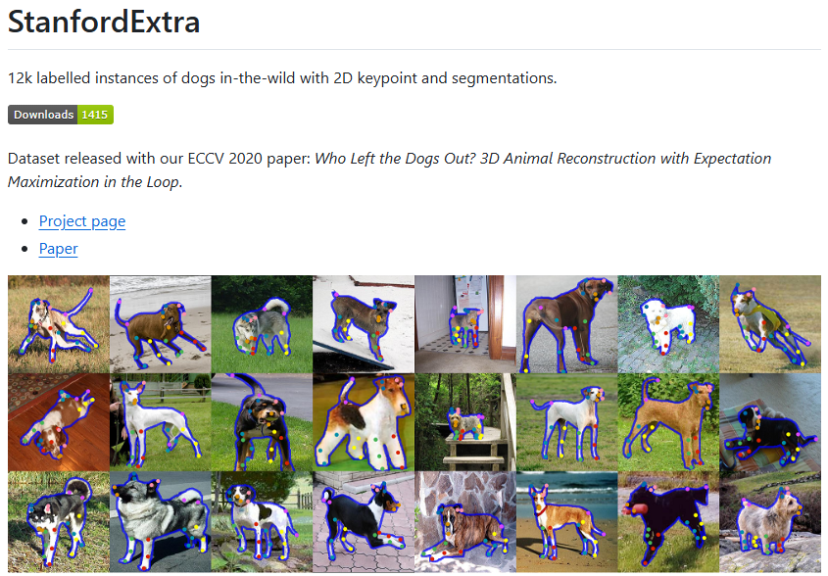

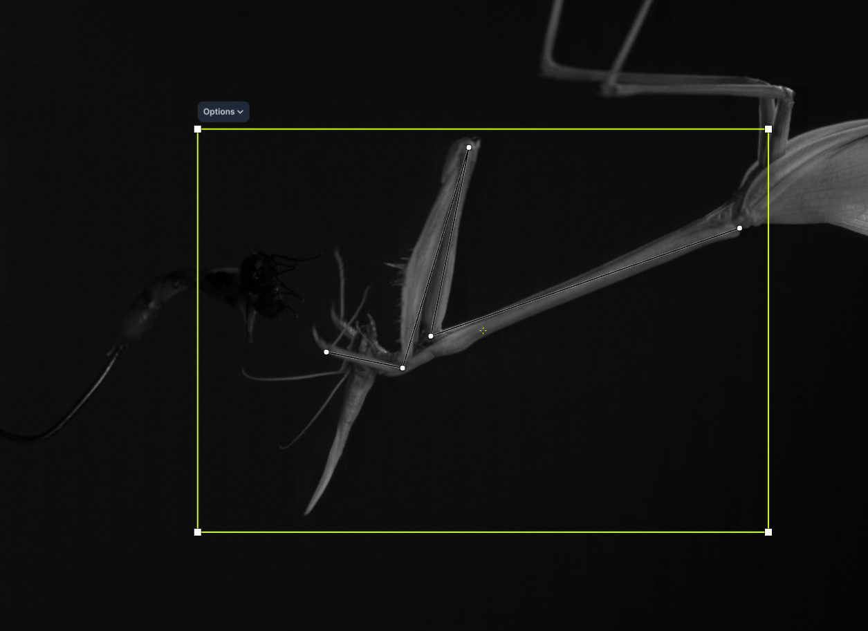
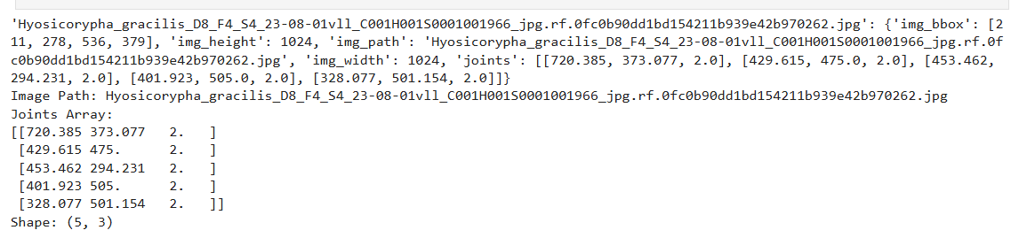
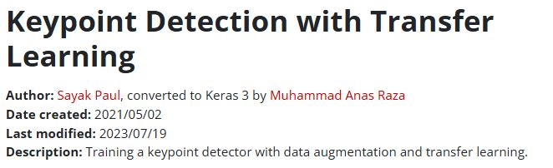
Literature research
Notes:
Literature Review: 1 slide highlighting related work.
Nochmal erwähnen dass wir vorher andere Quellen getestet haben und die hier vorgestellten geeinigt haben
StanfordExtra als vortrainierte Gundlage
Coco für Evaluation?
Roboflow für Keypoint definition und json datei -> Trainingsdatensatz

Slide 5
Dataset characteristics
Notes:
Dataset Characteristics: 1-2 slides.
Computer vision
Vll wie viele Bilder jedes Video eig hat, unterschiedliche Arten, 5 Keypoints pro Tier, Bounding Box (wofür genutzt?), Größe der Bilder und FPS Anzahl
1024+1024
1000-2000 relevant images per video
For one species, usually at least 10 specimens, at least 3 videos on different days -> more than 30 videos per species -> lots of data and lots of time evaluating the data

Slide 6
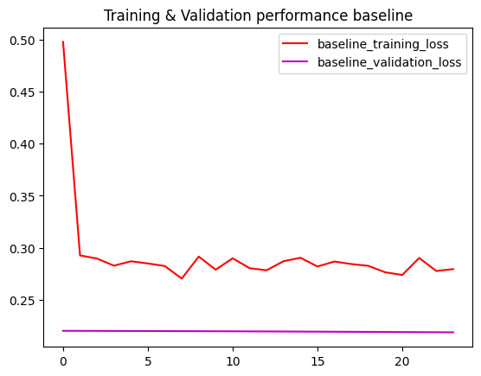
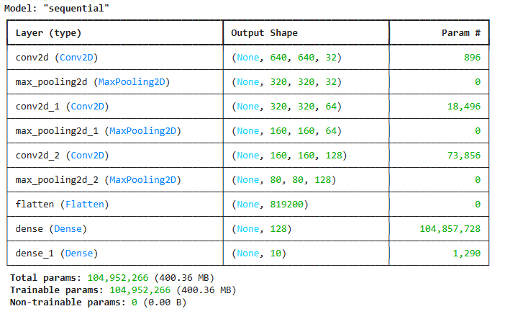
Baseline model
Deciding on „Baseline model“ was hard → We choosed „simple“ CNN architecture
Notes:
Baseline Model: 1 slide.
Einfaches CNN
Abbildung Model Summary + Prediction (hoffentlich richtig schlecht)
Außerdem: Baseline Model is auch Human
Linus

Slide 7
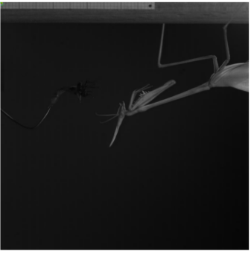
Baseline model- results
Deciding on „Baseline model“ was hard → We choosed „simple“ CNN architecture
Notes:
Baseline Model: 1 slide.
Einfaches CNN
Abbildung Model Summary + Prediction (hoffentlich richtig schlecht)
Außerdem: Baseline Model is auch Human
Linus

Slide 8
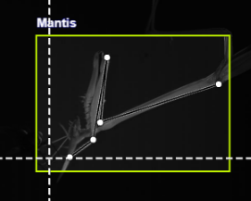

Data pipeline
Lab
Train: 170
Validation: 30
Test: 20
Annotation
Splitting
Notes:
Model Definition and Evaluation: 3-4 slides.
Augmentations (Extra Folie)
Linus

Slide 9
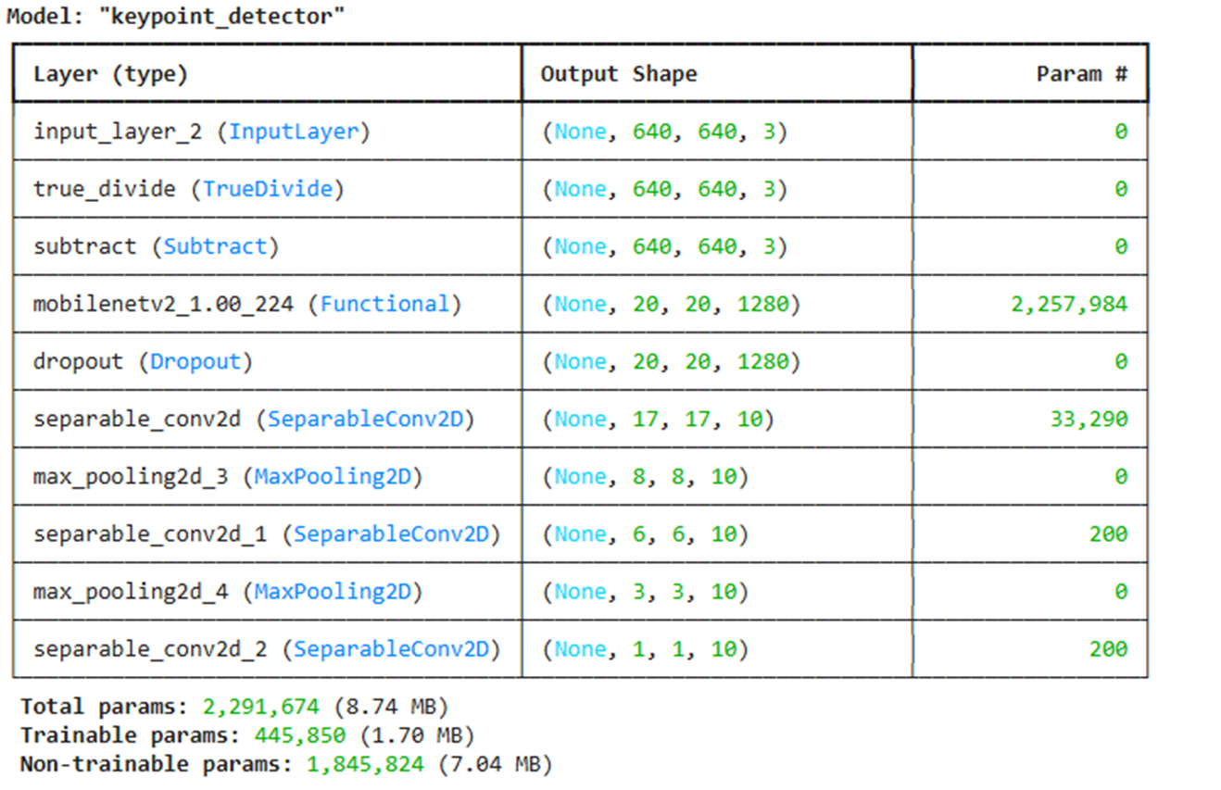
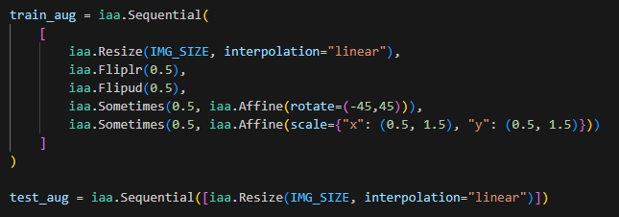
Data pipeline
Augmentation
Training
Notes:
Model Definition and Evaluation: 3-4 slides.
Augmentations (Extra Folie)
Linus

Slide 10
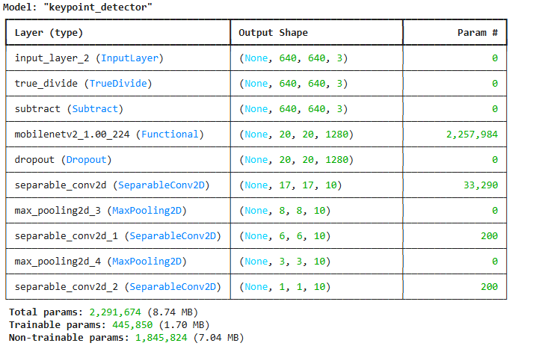

Model definition
Notes:
Model Definition and Evaluation: 3-4 slides.
Transfer klearning mit backbone
CNN da dran
Linus

Slide 11
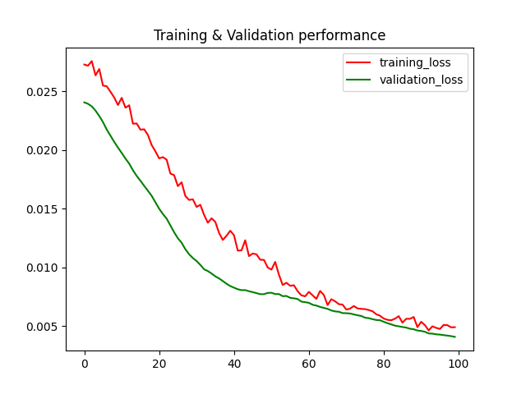
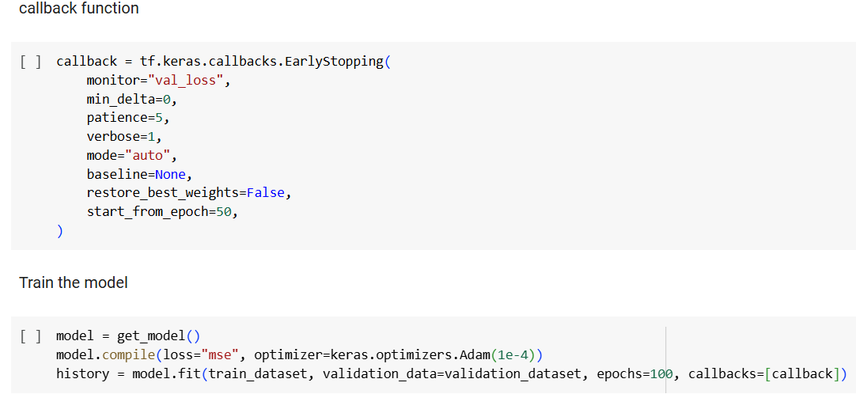
Model definition
Notes:
Model Definition and Evaluation: 3-4 slides.
Hyperparameter
Linus

Slide 12
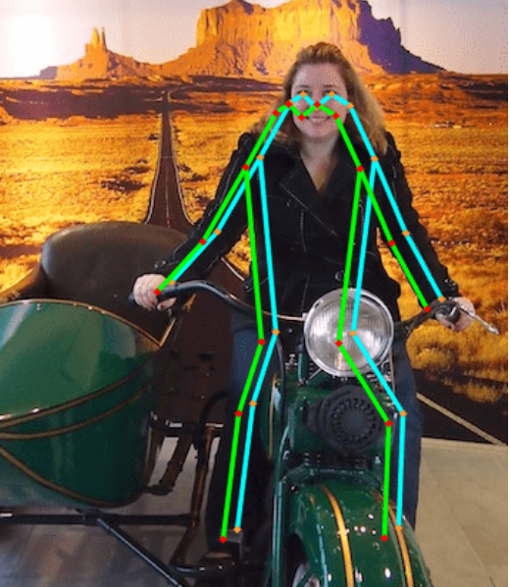
Model evaluation
OKS
Object Keypoint Similarity
distance between predicted and ground truth keypoints, normalized by object scale and keypoint visibility
Example of OKS on human
Notes:
Model Definition and Evaluation: 3-4 slides.
COCO Evaluation Metrics
COCO dataset (Common objects in Context)
Large-scale dataset mainly for object and keypoint detection in computer vision
Object Keypoint Similarity (OKS)
OKS, or Object Keypoint Similarity, is a way to measure how well a set of predicted points (keypoints) match the true points (keypoints) for an object in an image. You can think of it as a "matching score" between two sets of points, where a higher score means the predictions are closer to the truth.
Beispielbild? Analogie mit Überlappungen, hier wie der Abstand - über Threshhold definieren -> Linus
Alicem

Slide 13
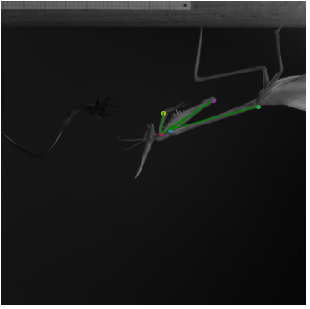
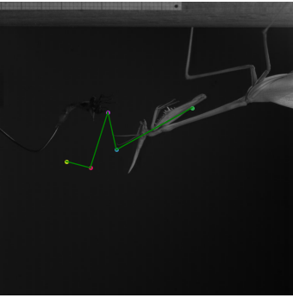
Results – cherry picked examples
Ground Truth
Test Prediction
Notes:
Results: 2-3 slides.
We suspect that the model has memorized the conventional pattern of the arm's pivot point positions rather than actually predicting the points correctly.
OKS vergleichen, Rückblickend auf Modelle
Alicem

Slide 14
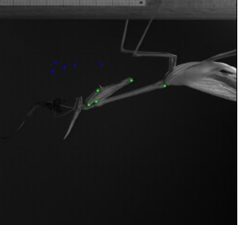
OKS
Predicted Values

Slide 15
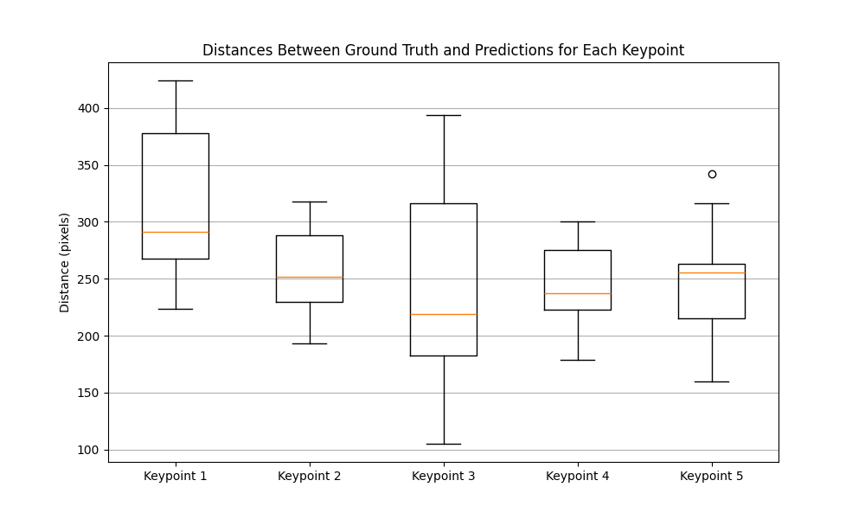
Alternative Metric (Euclidian Distance)
Test set Size = 30
3
5
1
4
2
Notes:
Results: 2-3 slides.
Euclidean distance is a way to measure how far two points are from each other in space. Imagine drawing a straight line between two points—Euclidean distance is simply the length of that line.
OKS vergleichen, Rückblickend auf Modelle
Alicem

Slide 16
Challenges
Choosing the right approach
Long Training Time
Setting sigma value for OKS
GitHub
Empty Space in images (pivot points lie close to each other)
Notes:
Challenges and Errors: 1 slide.
Sigma values define how sensitive the OKS metric is to the distance between predicted and ground truth keypoints, and they vary depending on the expected variability of each keypoint
Alicem

Slide 17
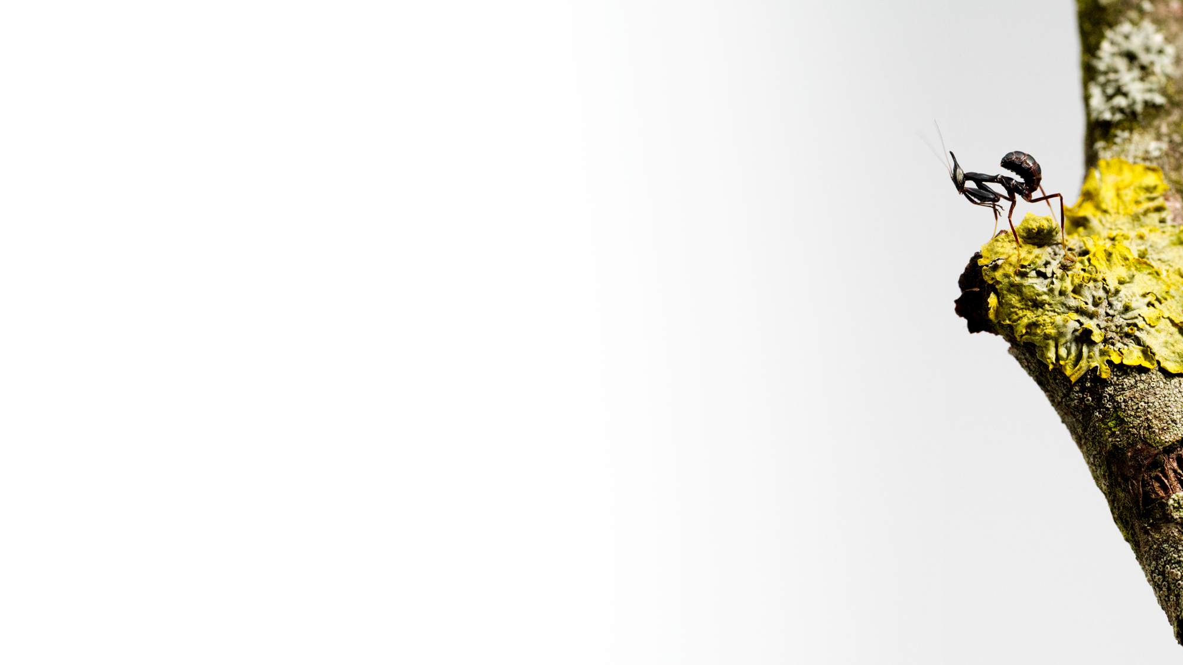
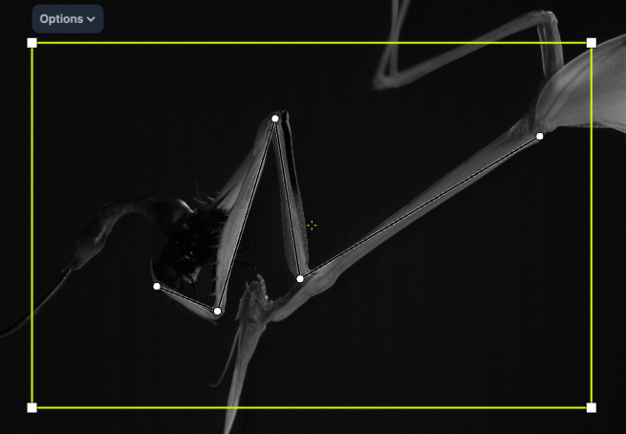
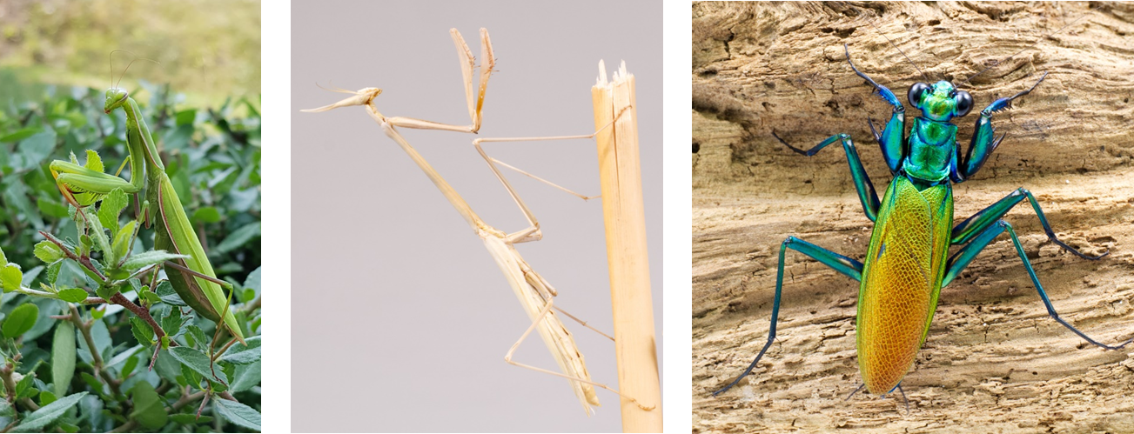
Conclusion and outlook
Manual pivot points
Predicted pivot points
Notes:
Conclusion and Future Work: 1 slide.
zusätzlich noch bounding boxes vorhersagen um “offset” bei test prediction zu vermeiden
Funktioniert überraschend gut,
Auf andere Arten ausweiten, vll tracking aus mehreren perspektiven?
Points nicht gut sichtbar -> liegen innen, schwierig zu beurteilen
Kernergebnisse nochmal übersichtlich aufführen
Fabian

Slide 18
To dos
Train also Bounding Boxes
Data Work
Annotate more Images
Take a deeper look at the data heterogeneous splits
Crop images to get rid of empty space
Work on better model architecture
Clean up Git
Notes:
Challenges and Errors: 1 slide.
Alicem

Slide 19
Conclusion and outlook
Manual pivot points
Predicted pivot points
Notes:
Conclusion and Future Work: 1 slide.
zusätzlich noch bounding boxes vorhersagen um “offset” bei test prediction zu vermeiden
Funktioniert überraschend gut,
Auf andere Arten ausweiten, vll tracking aus mehreren perspektiven?
Points nicht gut sichtbar -> liegen innen, schwierig zu beurteilen
Kernergebnisse nochmal übersichtlich aufführen
Fabian

